Slide 1
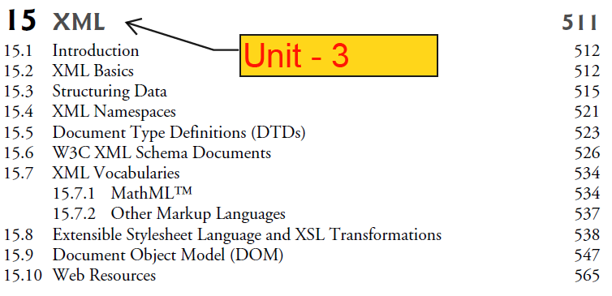

Slide 2
XML
XML stands for Extensible Markup Language.
XML was developed in 1996 by the World Wide Web Consortium’s (W3C’s) XML Working Group.
It is open technology for describing data.
XML tags are used to store and organize the data.
HTML is designed for representation of data on web page. (how to display)
XML is designed to store or to transport the data.
XML is designed to carry data, not to display data.
HTML contains various pre defined tags.
XML contains various user defined tags.

Slide 3
Features & Advantages of XML
Platform Independent & Language Independent.
XML is used for transport and storage of the data.
XML contains only data & does not contains any formatting information.
XML separates data from HTML.
XML allow user to build his own tags based on his web requirement.
Like: Mathematical formulas, chemical structure and so on…..

Slide 4
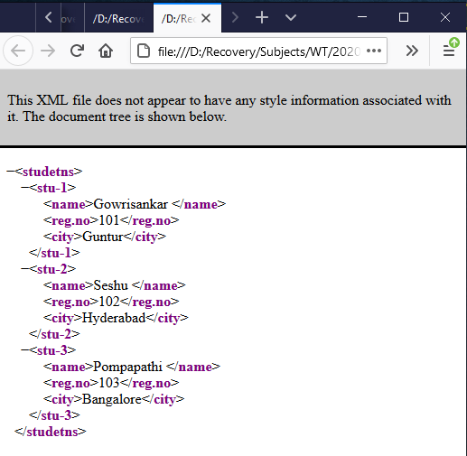
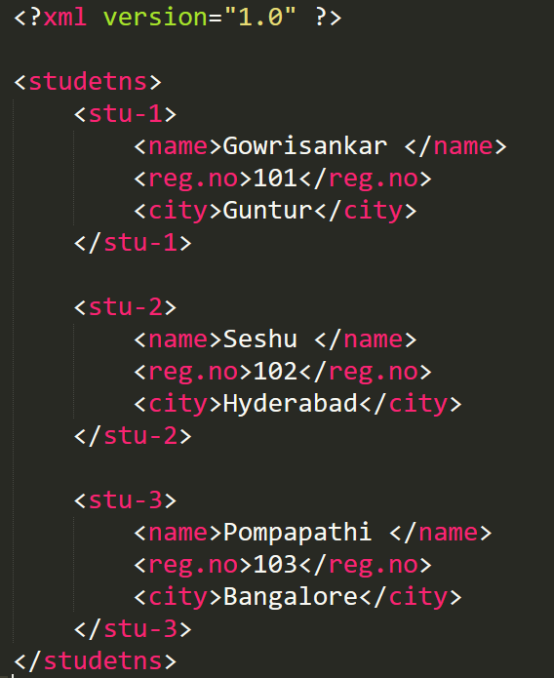
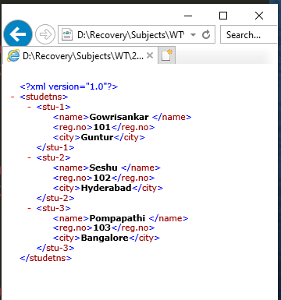
Simple XML Program

Slide 5
XML Program
XML program written in simple text editor.
Program can store with extension of ‘.xml’
XML document contains 2 parts
XML declaration (Prolog)
Body

Slide 6
1. XML declaration (Prolog)
XML document should start with a xml declaration. It is not mandatory.
UTF = Unicode Transformation Format
XML declaration must be placed as the first line in the XML document.
If the XML declaration is included, it must contain version number attribute.
Parameter names and values are case-sensitive. names are always in lower case.
The parameter order is: version, encoding and standalone.
Either single or double quotes may be used.
The XML declaration has no closing tag i.e. </?xml>

Slide 7
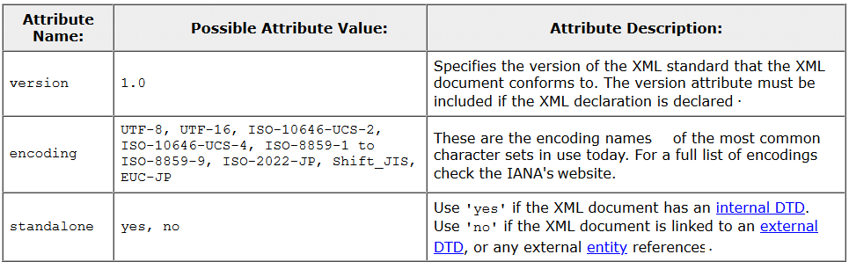
1. XML declaration

Slide 8
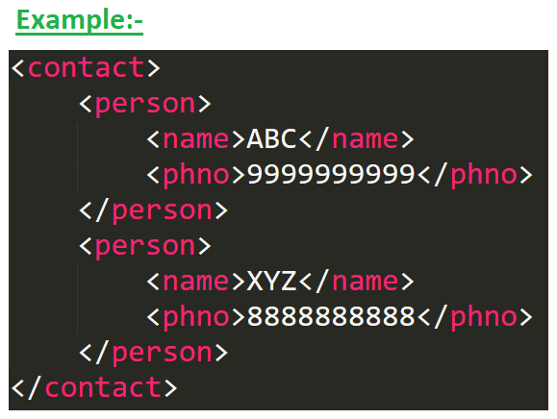
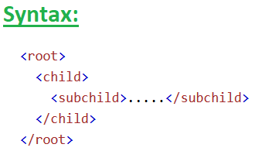
2. Body Part
XML documents must contain one root element that is the parent of all other elements.
The root element must be the top element and it can be only one root element.
Elements are ‘case sensitive’
Spaces and tabs are not allowed in the name of element.
Each stating tag must have matching ending tag
https://xmlwriter.net/xml_guide/doctype_declaration.shtml

Slide 9
Comments in XML
XML comments are similar to HTML comments.
The comments are added as notes or lines for understanding the purpose of an XML code.
Syn: - <!-- Your Commenet -->
Comments cannot appear before XML declaration.
Comments may appear anywhere in a document.
Comments must not appear within attribute values.
Do not use double hyphen ‘--‘ with in comment.
Comments cannot be nested inside the other comments.
https://xmlwriter.net/xml_guide/doctype_declaration.shtml

Slide 10
Special characters
In XML some characters are special meaning.
&lt → (<),
&amp → (&),
&gt → (>),
&quot → ("), and
&apos → (')

Slide 11
Viewing & modifying XML document
Viewing and modifying an XML document – which is text file the usually ends with the .xml
Validating XML document
Can required DTD or Schema that defines the proper structure of the XML document.
Formatting & Manipulating XML document
Most XML documents contains only data, not a formatting instructions, so xml document must decide how to manipulate or display the data.

Slide 12
XML Namespaces
XML Namespace is a mechanism to avoid name conflicts by differentiating elements or attributes within an XML document that may have identical names, but different definitions
Some times we need to create two different elements by the same name.
The xml document allow us to create different elements which are having the common name.
XML namespace is a collection of elements and attribute names.
Name conflicts in XML can easily be avoided using a name prefix and colon.
Example: -

Slide 13
XML DTDs

Slide 14
XML DTD
DTD = Document Type Definitions
The purpose of DTD is to define the legal building blocks of an XML document.
Defines the documents grammar.
Used to specify set of rules for structuring data in any xml file.
Using DTD we can specify the various elements types, attributes and their relationship with one another.
XML documents can have many different structures, and for this reason an application cannot be certain whether a particular document it receives is complete, ordered properly, and not missing data.
DTDs and schemas solve this problem by providing an extensible way to describe XML document structure.
Applications should use DTDs or schemas to confirm whether XML documents are valid.
DTD describes the structure of an XML document and enables an XML parser to verify whether an XML document is valid .

Slide 15
XML DTD Types
DTD describe the structure of an XML document and enables an XML parser to verify whether an XML document is valid.
DTD’s allow users to check document structure and to exchange data in a standardized format.
There are two types of DTD’s
Internal DTD
External DTD

Slide 16
Well-Formed Vs Valid Document
Well-Formed document means syntactically correct (starting tag, ending tag, Synatx, …..)
Valid document contains the proper elements with the proper attributes in the proper sequence.
An XML Schema describes the structure of an XML document, just like a DTD.
An XML document with correct syntax is called "Well Formed".
An XML document validated against an XML Schema is both "Well Formed" and "Valid".

Slide 17
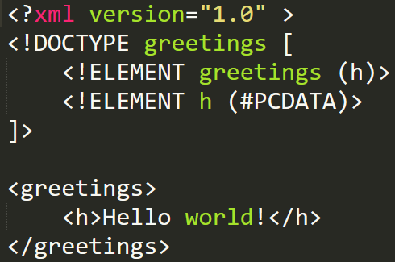
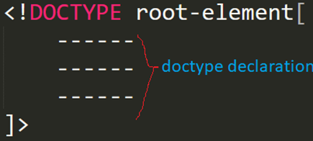
1) Internal DTD
The DTD can be embedded directly in the XML document as a part of it called internal DTD.
The DTD information is placed between the square brackets in a DOCTYPE declaration
The keyword DOCTYPE must be in uppercase
DOCTYPE must appear before the first element in the document.

Slide 18
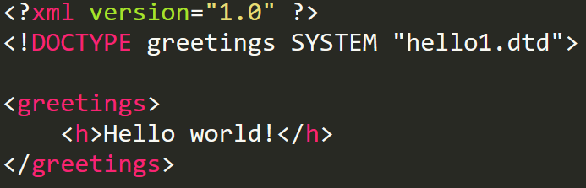
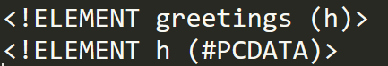
2) External DTD
The DTD can be stored in separate file and put DTD information in the XML file.
Syntax:-
Ex:-
.dtd file

Slide 19
Declaring Multiple Children's
<!ATTLIST Element-name attribute-name att-type def-val>
Occurrence Indicator
Sequence | (name, rollno,address)
Choice | (price|discount)
None | Exactly one Occurance
* | 0 or more
+ | one or more
? | zero or one
Attribute Declaration
Default value of Attribute
Default | Default Value
#REQUIRED | Attribute is Required
#IMPLIED | Attribute is not Required
#FIXED | Attribute is Fixed

Slide 20
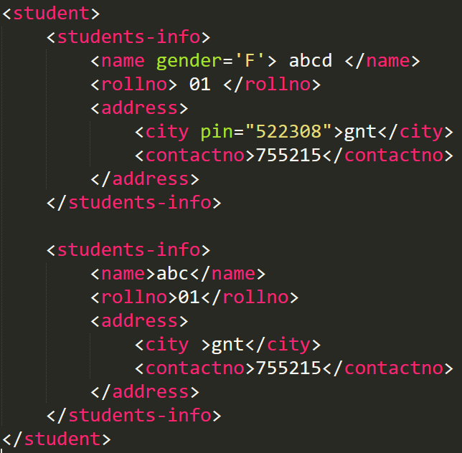
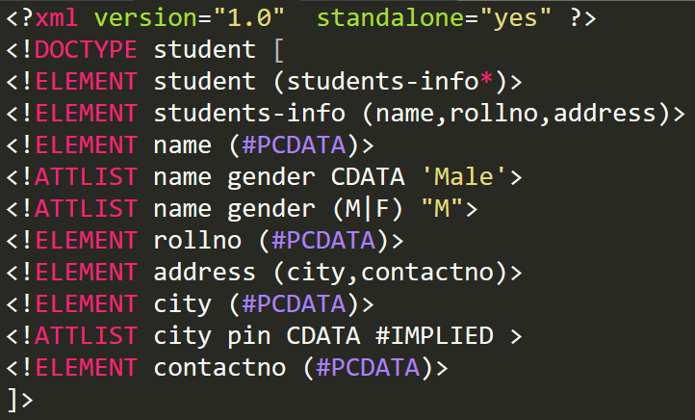
Internal DTD

Slide 21
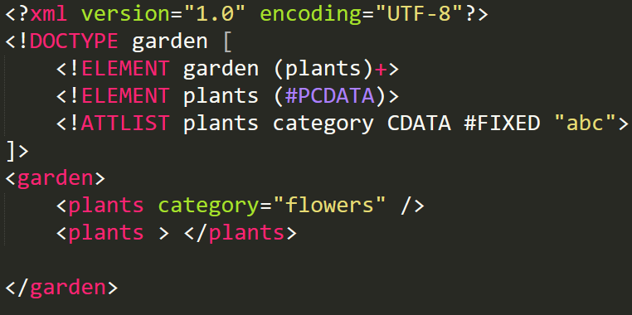
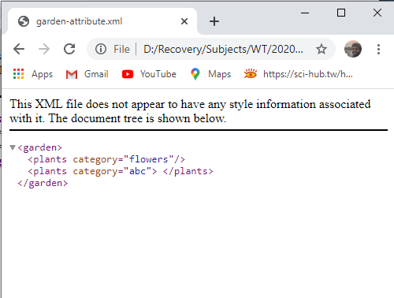
Internal DTD

Slide 22
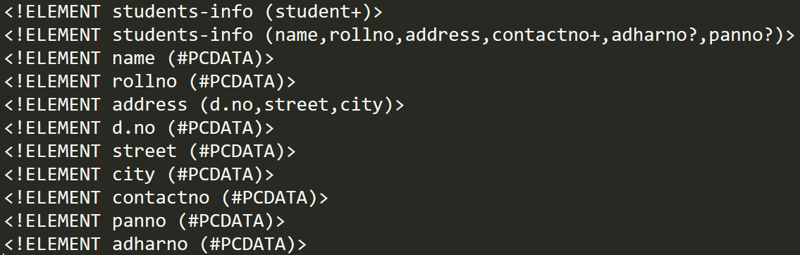
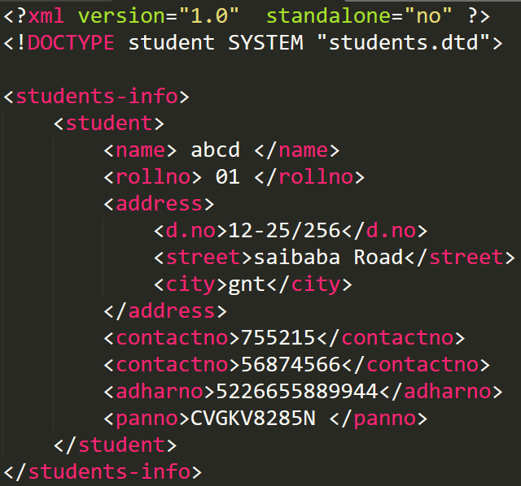
External DTD
File Name = Stdents.dtd
File Name = Stdent-External.xml

Slide 23
XML Schemas

Slide 24
XML Schema
XML Schema is an XML-based alternative to DTD:
An XML Schema describes the structure of an XML document, just like a DTD.
An XML document with correct syntax is called "Well Formed".
An XML document validated against an XML Schema is both "Well Formed" and "Valid".
XML schema language is called as XML XML schema Definition(xsd) language
Advantages:-
It provide a list of elements and attributes.
It is easier to define restrictions, patterns.
It validate the correctness of data.
XML Schemas support data types (integer, string, …)and namespaces
You can use your XML parser to parse your Schema files

Slide 25
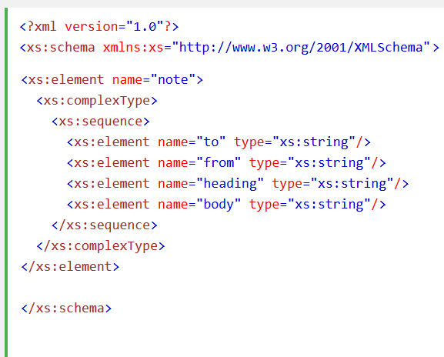
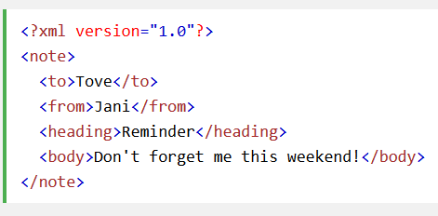
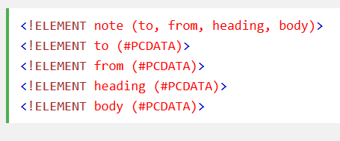
Note.xsd
Note.xml
Note.dtd

Slide 26
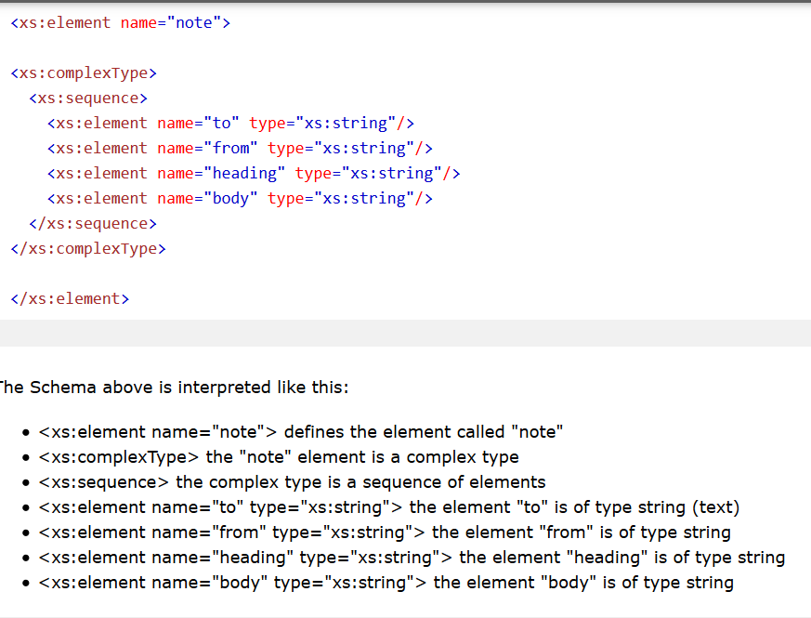
Example.xsd

Slide 27
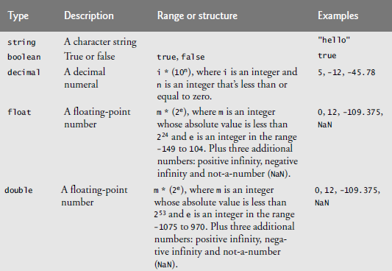
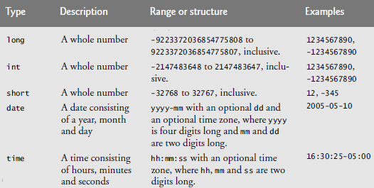
Data Types

Slide 28
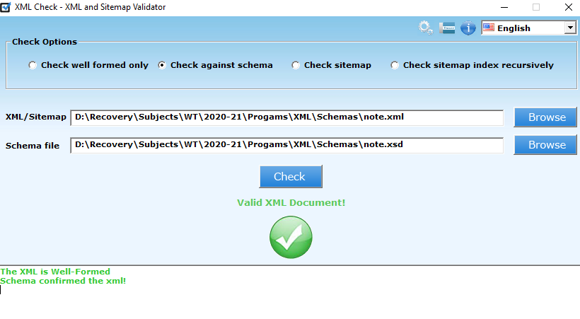
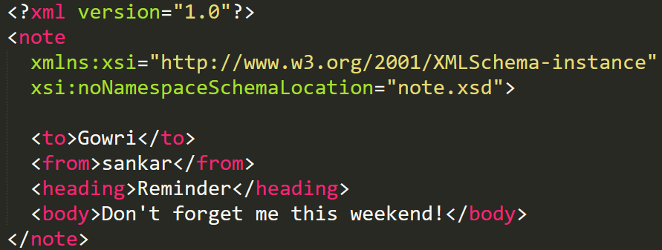
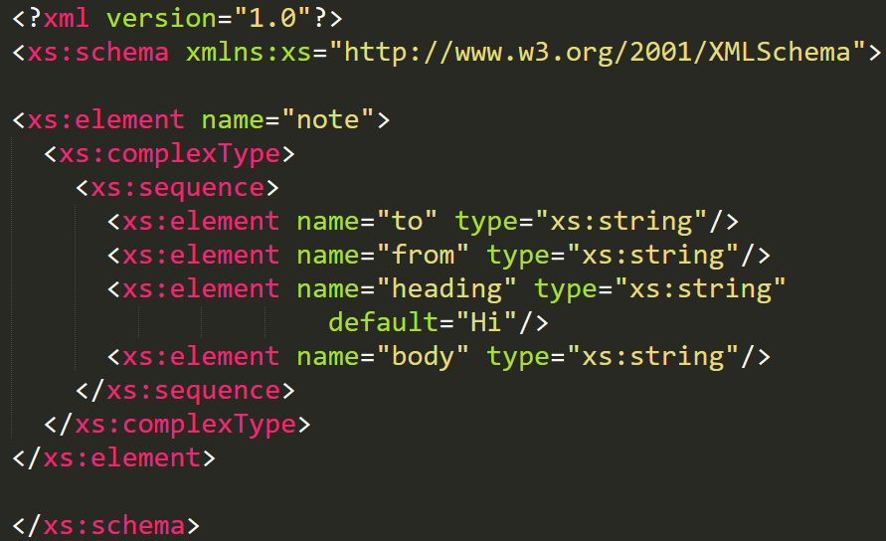
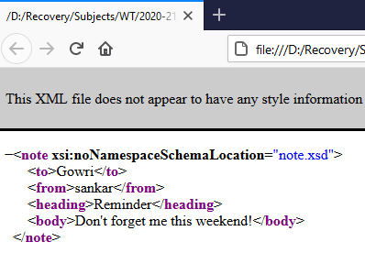
XML Schema – Example_1
File Name = note.xml
File Name = note.xsd

Slide 29
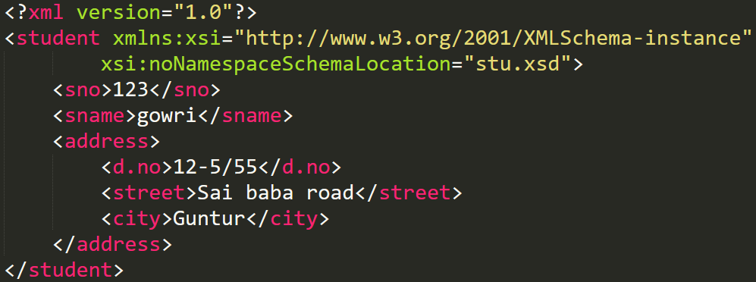
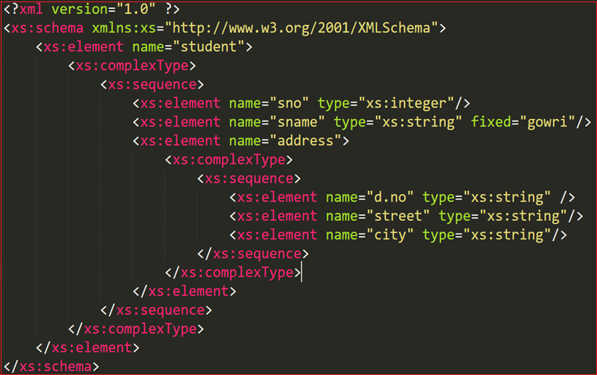
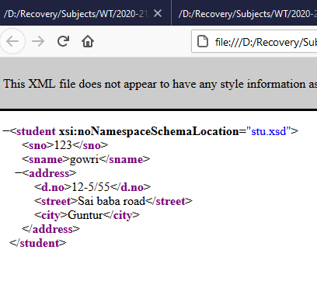
XML Schema – Example_2
File Name = Student.xml
File Name = stu.xsd

Slide 30
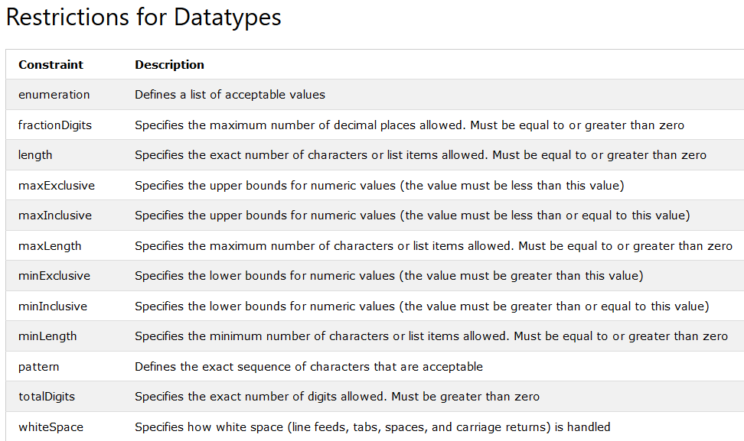

Slide 31
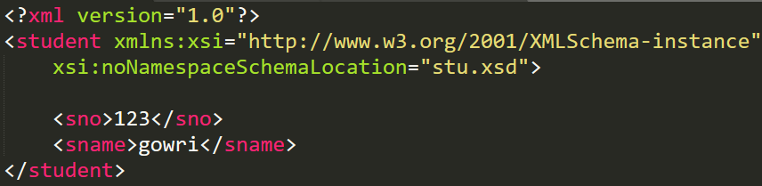
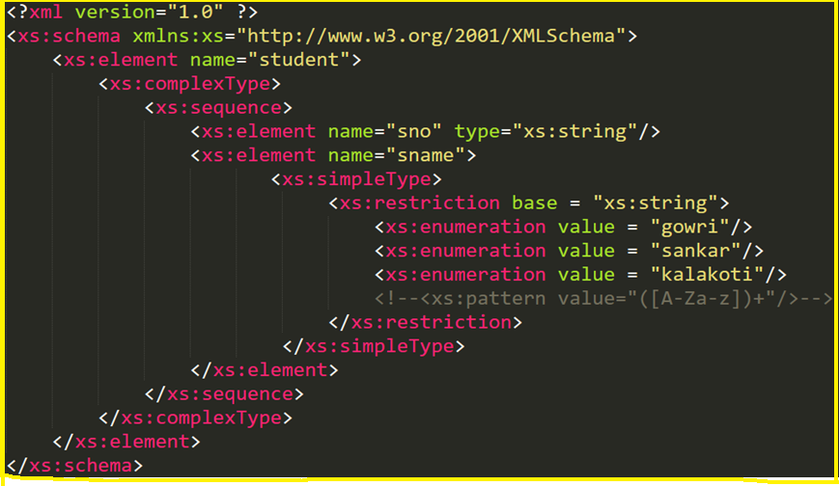
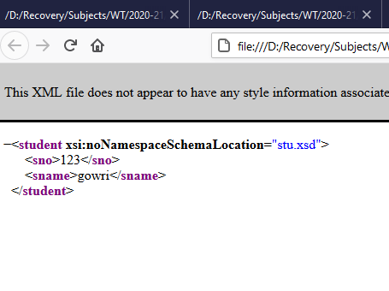
XML Schema – Example_3
File Name = Student.xml
File Name = stu.xsd

Slide 32
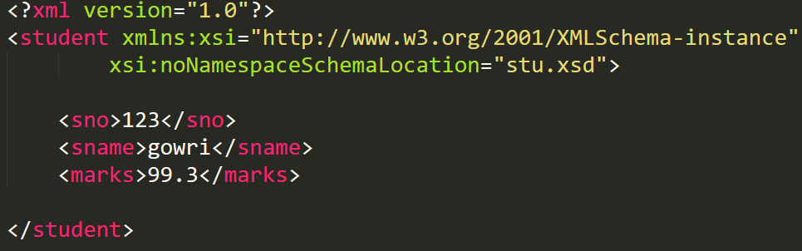
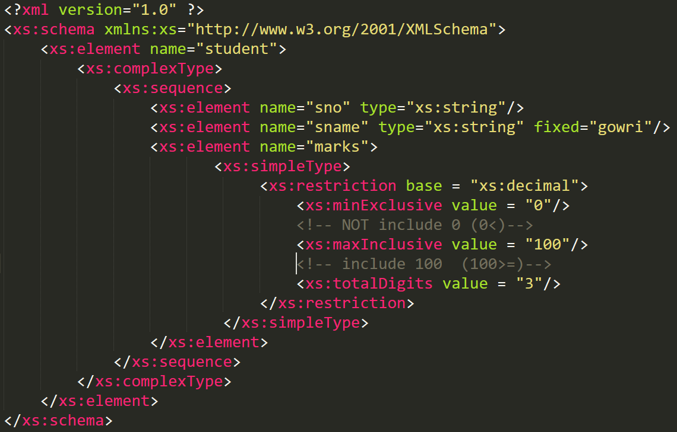
XML Schema – Example_4
File Name = Student.xml
File Name = stu.xsd

Slide 33
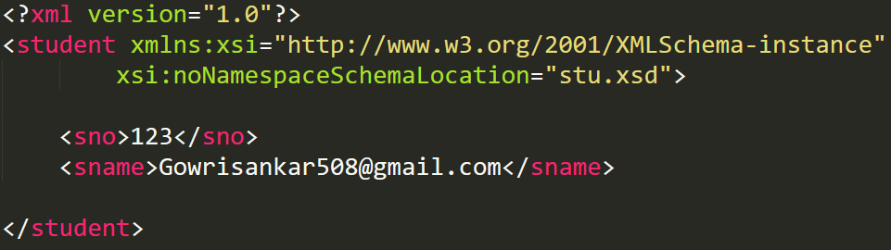
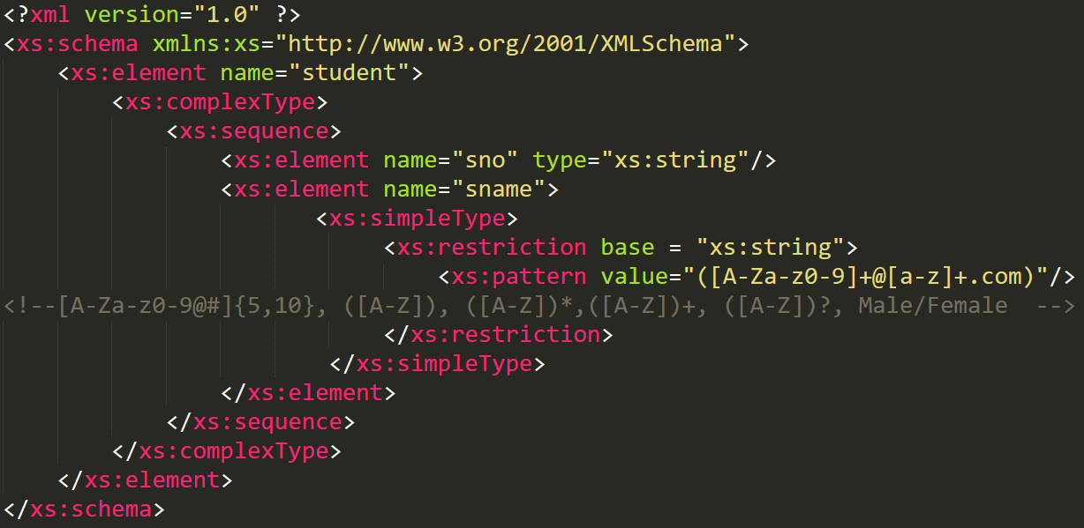
XML Schema – Example_4
File Name = Student.xml
File Name = stu.xsd

Slide 34
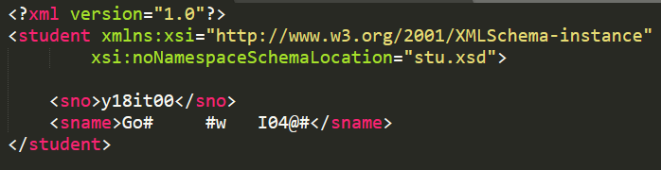
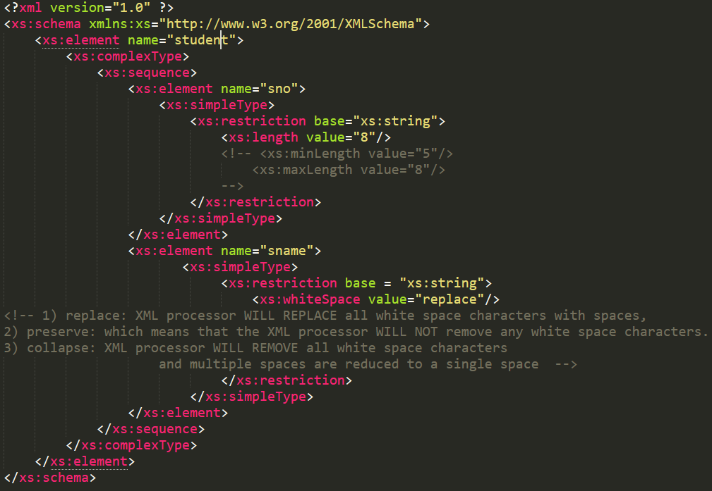
XML Schema – Example_4
File Name = Student.xml
File Name = stu.xsd

Slide 35
Math ML
&
Other Mark-up Languages

Slide 36
Math ML
MathML stands for Mathematical Markup Languages.
W3C developed for describing mathematical notations and expressions.
MathML markup describes mathematical expressions for display.
MathML is divided into two types of markup
1) Content Markup
2) Presentation Markup
Content Markup:- Content MathML allows programmers to write mathematical notation specific to different areas of mathematics.
Ex:- &minus, &delta,…..
2) Presentatin Markup:- Presentation MathML is directed toward formatting and displaying mathematical notation.
Ex:- mrow, msup, mo, mi, ….

Slide 37
Math ML
https://www.javatpoint.com/mathml-tutorial
1 | <mrow> | used to group any number of sub expressions horizontally.
2 | <mi> | used to specify an identifier (Operands).
4 | <mo> | used to specify an operator.
5 | <mn> | used to specify a numeric literal.
6 | <ms> | used to specify a string literal.
8 | <math> | It is the top-level element in MathML . Every valid MathML instance must be wrapped in <math> tags.
9 | <msqrt> | The MathML <msqrt> element is used to display square roots.
10 | <msub> | The MathML <msub> element is used to attach a subscript to an expression. It uses the following syntax: <msub> base subscript </msub>.
11 | <msup> | The MathML <msup> element is used to attach a superscript to an expression. It uses the following syntax: msup base superscript </msup>.
13 | <mfrac> | Used to display fractions.
14 | <mtable> | Used to create tables or matrices. Inside a mtable only mtr and mtd elements may appear. These elements are similar to table, tr and td elements of HTML.
15 | &int; | Integral entities
17 | &minus; | Minus entities
18 | &delta | display lowercase Delta symbol
19 | &InvisibleTimes | Multiple Operator

Slide 38
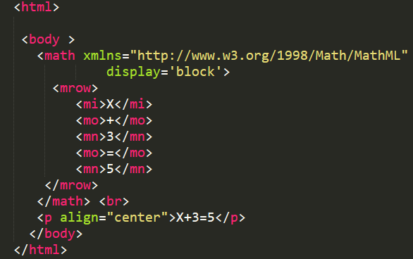
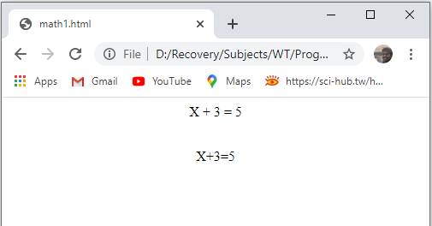
MathML Example -1

Slide 39
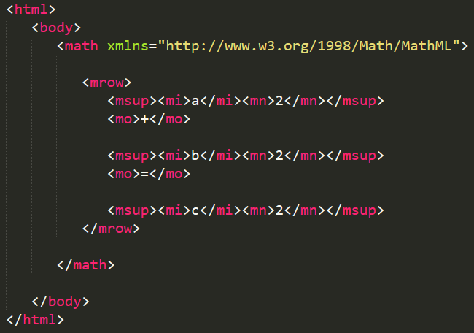
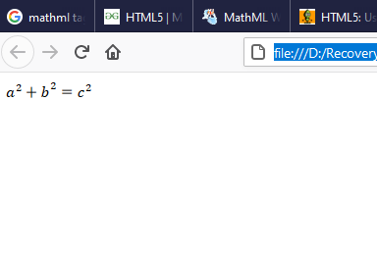
Example 2 - Square

Slide 40
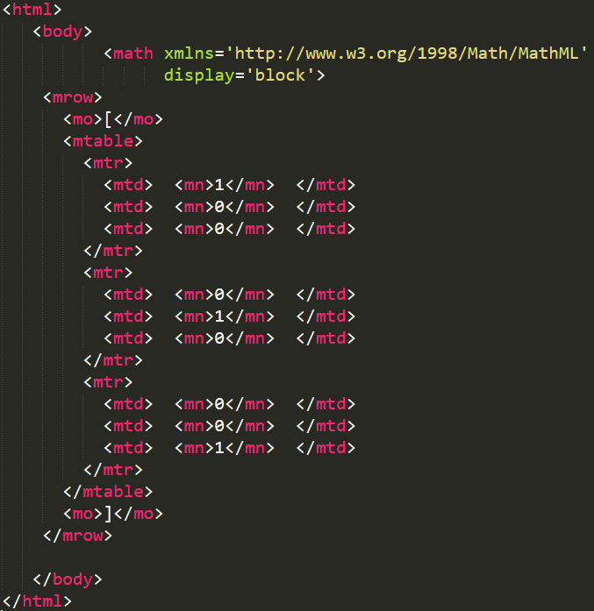
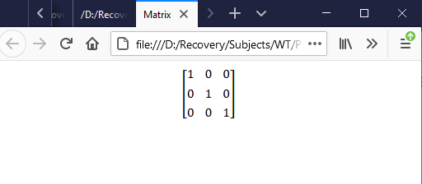
Example 3 - Matrix

Slide 41
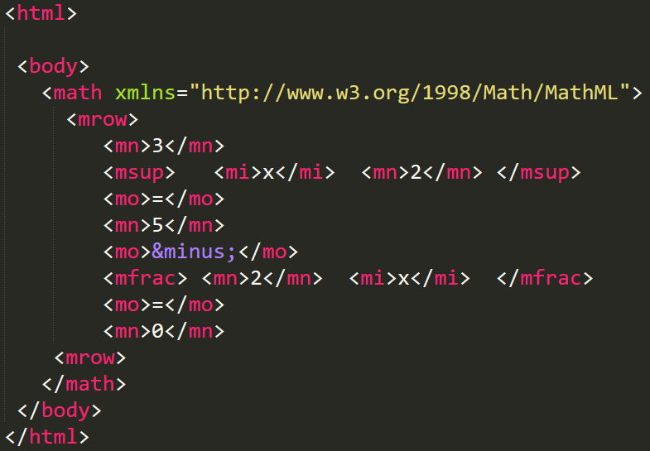
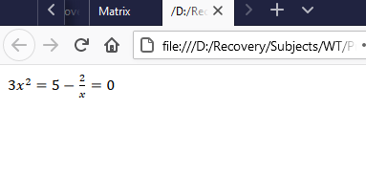
Example 4 - Algebra Equations

Slide 42
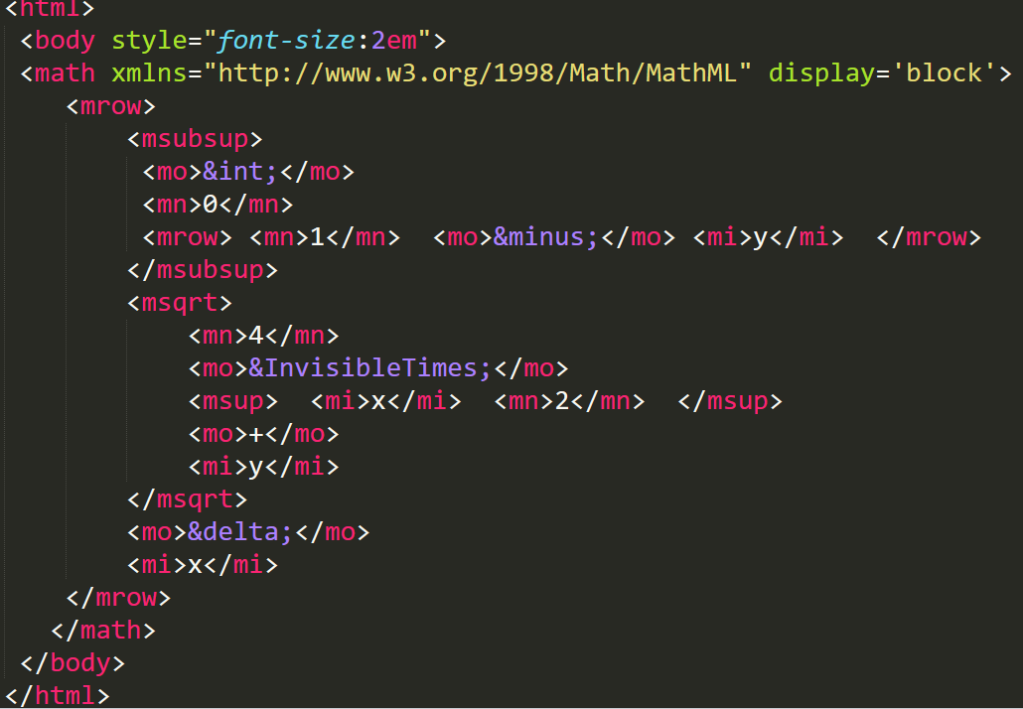
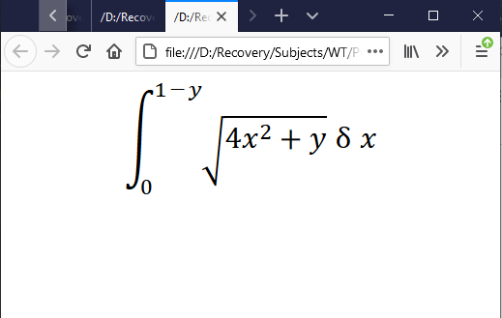
Example 5 - Calculus Equations

Slide 43

various Markup Languages derived from XML

Slide 44
XSL & XSLT

Slide 45
XSL
XSL stands for “EXtensible Stylesheet Language”.
It is Style sheet language for XML document.
XML doesnot use predefined tags.
CSS used for Style sheets for HTML.
XSL used for Style sheets for XML.
In case of XML documents, tags are not predefined. In order to understand and style an XML document, World Wide Web Consortium (W3C) developed XSL which can act as XML based Stylesheet Language.

Slide 46
XSL and XSLT
XSL consists of Three Technologies:-
1) XSL-FO (XSL Formatting Objects)
2) XPath (XML Path Language)
3) XSLT (XSL Transformations)
XSLT − used to transform XML document into various other types of document.
XPath − used to navigate XML document.
XSL-FO − used to format XML document.

Slide 47

XSLT
XSLT is a language for Transforming XML document into other documents.
With XSLT you can add/remove elements and attributes to or from the file.
You can also rearrange and sort elements.
XSLT transforms an XML source tree into an XML result tree.

Slide 48


XSL Declaration
The root element that declares the document to be an XSL stylesheet is
<xsl:stylesheet> (or) <xsl:transform>
XML file syntax
XSL file syntax

Slide 49

XSLT Elements

Slide 50
XSLT Elements
There are several predefines XSL elements to perform various operations.
Template | Contains rules to apply when specified node is matched.
Value-of | Select the vale of an ML element and adds it to the output
for-each | Applies a template to every nde selected by the Xpath specified by the select attribute.
sort | used to sort the output
apply-templates | applies a template to the current element or child nodes
if | used to put conditional test.
choose (when, otherwise) | used to put multiple conditional test.

Slide 51

XSL Example -1
Student XML File

Slide 52

XSL Example -1
Stu-valueof XSL File

Slide 53
XSLT Elements
There are several predefines XSL elements to perform various operations.
Template | Contains rules to apply when specified node is matched.
Value-of | Select the vale of an ML element and adds it to the output
for-each | Applies a template to every nde selected by the Xpath specified by the select attribute.
sort | used to sort the output
apply-templates | applies a template to the current element or child nodes
if | used to put conditional test.
choose (when, otherwise) | used to put multiple conditional test.

Slide 54
XSL Example -2
Student XML File

Slide 55

XSL Example -2
Stu-foreach XSL File

Slide 56
XSLT Elements
There are several predefines XSL elements to perform various operations.
Template | Contains rules to apply when specified node is matched.
Value-of | Select the vale of an ML element and adds it to the output
for-each | Applies a template to every nde selected by the Xpath specified by the select attribute.
sort | used to sort the output
apply-templates | applies a template to the current element or child nodes
if | used to put conditional test.
choose (when, otherwise) | used to put multiple conditional test.

Slide 57

XSL Example -3
Stu-sort XSL File

Slide 58
XSLT Elements
There are several predefines XSL elements to perform various operations.
Template | Contains rules to apply when specified node is matched.
Value-of | Select the vale of an ML element and adds it to the output
for-each | Applies a template to every nde selected by the Xpath specified by the select attribute.
sort | used to sort the output
apply-templates | applies a template to the current element or child nodes
if | used to put conditional test.
choose (when, otherwise) | used to put multiple conditional test.

Slide 59

XSL Example -4
Stu-if XSL File

Slide 60
XSLT Elements
There are several predefines XSL elements to perform various operations.
Template | Contains rules to apply when specified node is matched.
Value-of | Select the vale of an ML element and adds it to the output
for-each | Applies a template to every nde selected by the Xpath specified by the select attribute.
sort | used to sort the output
apply-templates | applies a template to the current element or child nodes
if | used to put conditional test.
choose (when, otherwise) | used to put multiple conditional test.

Slide 61

XSL Example -5
Stu-choose XSL File

Slide 62

DOM
DOM stands for “Document Object Model”
It defines the logical structure of documents and the way a document is accessed and manipulated.
The DOM tree has a single root node, which contains all the other nodes in the document.

Slide 63
Web Servers
Apache and IIS
web server—that responds to client requests by providing resources such as XHTML documents.
For example, when users enter a Uniform Resource Locator (URL) address, such as www.deitel.com, into a web browser, they’re requesting a specific document from a web server. The web server maps the URL to a resource on the server (or to a file on the server’s network) and returns the requested resource to the client

Slide 64



Slide 65
Web Servers
Apache and IIS
Apache is the most widely used web server software. Developed and maintained by Apache Software Foundation, Apache is an open source software available for free. It runs on 67% of all webservers in the world. It is fast, reliable, and secure. It can be highly customized to meet the needs of many different environments by using extensions and modules.
Internet Information Services server (IIS server) is a Windows Server-based web application used to deliver website content over the internet to an end user. Internet Information Services is an installable server role, and it is bundled with all Microsoft Windows Server products

